Slide 1
CARCINOMA OF
LARGE INTESTINE
The malignant tumor
developing from elements
of a epithelium mucous a large intestine
C18 Malignant neoplasm of a colonic intestine (including caecum and appendix)
C19 Malignant neoplasm of rectosigmoid part
C20 Malignant neoplasm of a rectum

Slide 2
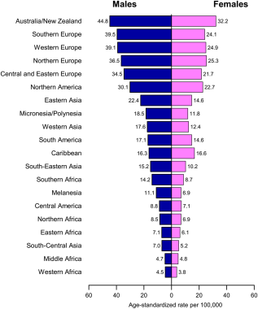
Colon Cancer Incidence Rates by Sex and World Area
CA: A Cancer Journal for Clinicians
Volume 65, Issue 2, pages 87-108, 4 FEB 2015 DOI: 10.3322/caac.21262
http://onlinelibrary.wiley.com/doi/10.3322/caac.21262/full#caac21262-fig-0008
Notes:
Stomach Cancer Incidence Rates by Sex and World Area.
IF THIS IMAGE HAS BEEN PROVIDED BY OR IS OWNED BY A THIRD PARTY, AS INDICATED IN THE CAPTION LINE, THEN FURTHER PERMISSION MAY BE NEEDED BEFORE ANY FURTHER USE. PLEASE CONTACT WILEY'S PERMISSIONS DEPARTMENT ON PERMISSIONS@WILEY.COM OR USE THE RIGHTSLINK SERVICE BY CLICKING ON THE 'REQUEST PERMISSIONS' LINK ACCOMPANYING THIS ARTICLE. WILEY OR AUTHOR OWNED IMAGES MAY BE USED FOR NON-COMMERCIAL PURPOSES, SUBJECT TO PROPER CITATION OF THE ARTICLE, AUTHOR, AND PUBLISHER.

Slide 3
,00Incidence in USA 35,8 per100,000
In developing countries < 10 per 100,000
In India incidence - 7 per100,000 d
i
Mortality from a colon cancer on the second place after lung cancer

Slide 5
Structure of cancer cases of men in Russia in 2018
12,1%

Slide 6
Structure of cancer cases of women in Russia in 2018
11,9%

Slide 7
Etiology
Heredity and family history (about 5% of patients)
Familial adenomatous polyposis (FAP) is the second most common predisposing genetic syndrome, and is characterized by the
development of hundreds to thousands of colorectal polyps in affected individuals.

Slide 8
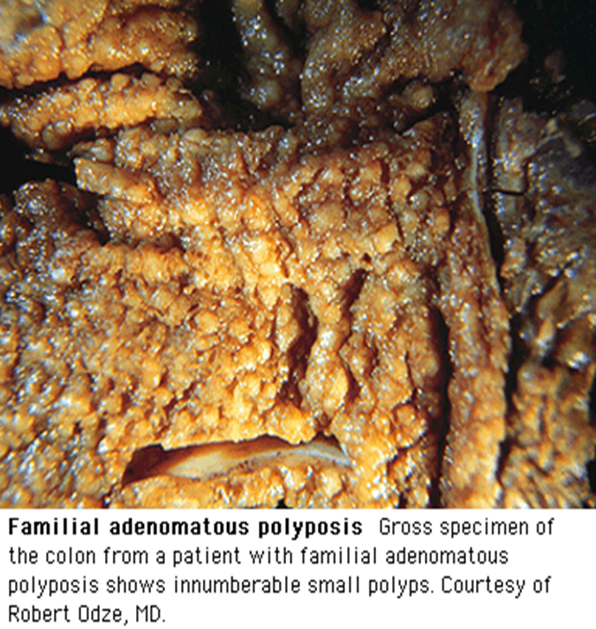

Slide 9
Lynch syndrome families
Syndrome of a heriditary not polypostural colon cancer
in the US found lifetime risks of 66% in men and 43% in women
The mutation of genes of hMSH2 and hMLH1 is noted at 70% of patients. At the type «a» cancer arises only in a large intestine, in the type «b» at the same time there can be tumors in endometrium or a stomach, a brain, a mammary gland, or genitourinary, gepatobiliary system.
Li-Fromeni's syndrome, Gardner's syndrome, Peyttsa-Egers's syndrome, family juvenile polyposes.

Slide 10
2. Not heriditary-sporadic CRC
Not heriditary-sporadic CRC makes about 95% of cases of a colon cancer
APC gene mutations - loss of an allele in the 5th chromosome at - 30-50% of patients

Slide 11
Summary of Selected Risk Factors for Colorectal Cancer
that increase risk:
Heredity and Medical History
Family history 1 first-degree
relative more than 1
relative with diagnosis before age 45
Inflammatory bowel disease Crohn disease (colon)
Ulcerative colitis colon
rectum
Diabetes
Relative Risk*
Factors
2.2
4.0
3.9
2.6
2.8
1.9
1.2

Slide 12
Summary of Selected Risk Factors for Colorectal Cancer
that increase risk:
Behavioral factors
Alcohol consumption (heavy vs. nondrinkers)
Obesity
Red meat consumption
Processed meat consumption Smoking (current vs. never)
Relative Risk*
Factors
1.6
1.2
1.2
1.2
1.2

Slide 13
Summary of Selected Risk Factors for Colorectal Cancer
Factors that decrease risk:
Physical activity (colon)
Dairy consumption
Fruit consumption
Vegetable consumption
Total dietary fiber (10 g/day)
Relative Risk*
Factors
0.7
0.8
0.9
0.9
0.9

Slide 14
Precancerous diseases of a large intestine:
1. Single and multiple polyps
Risk of a malignancy of a polyp at the sizes to 1 cm-1,1 %, 1-2 cm-7,7 %, 2 cm – 42%.
2. Nonspecific ulcerative colitis
The risk of development of cancer lasting disease more than 10 years increases up to 20%,
30 years – 60%.
3. Illness Krone of a large intestine.

Slide 15
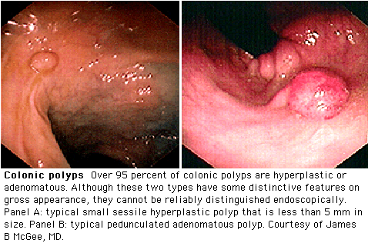
A
B

Slide 16
Classification
Patomorphological
A. Exophytic (Fungating)
B. Endophytic (and Ulcerative)
C. Stenosing (annular, constricting, circumferrential)
D. Diffuse - infiltrative

Slide 17
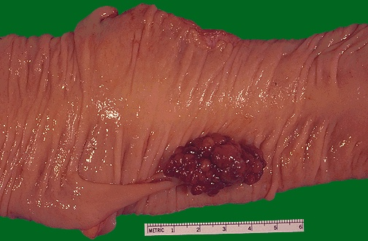
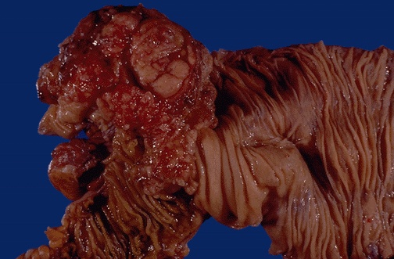
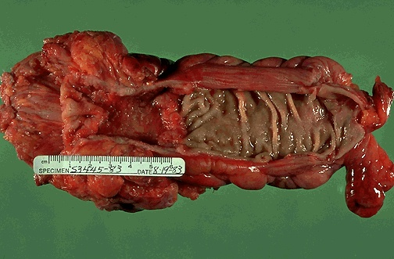
A
B
C
Notes:
Gross - Fungating (Exophytic)/ Ulcerative/ Stenosing(annular/ constricting/ circumferrential)

Slide 18
PATHOLOGY: WHO Classification
I. Epithelial
    Adeno Ca >95%
    Mucinous adeno Ca 17%
    Signet ring cell Ca 2-4%
    Squamous cell carcinoma
    (SCC)
    Adenosquamous
    Undifferentiated
    Unclassified
II. Neuroendocrinal – carcinoid
III. Nonepithelial (sarcoma)
  Leiomyosarcoma
  Liposarcoma
  Angiosarcoma etc.
IV. Hematopoietic/ lymphoid(DLBCL)
V. Unclassified
VI. Secondaries
VII. Tumor - like lesions
VIII. Epithelial atypia in Ulcerative colitis
Notes:
Grading- Adeno ca only histologic type further classified by grades by BRODER (1920) based on percentage of differentiated cells found in the overall tumor specimen
(I)-Well diff. (II)-Moderately diff. (III)-Poorly diff. (IV)- Undifferentiated
DUKE (1932)- based on cytological characteristics or cells/ glandular formation and nuclear pleomorphism ranging from A (Well diff.) to D (Anaplastic)
Present day- Three grade system

Slide 19
Features of microanatomy of a wall of a colonic intestine
Thickness of a wall of a colonic intestine makes in the studied cases from 495 to 3501 microns in intertenial areas and from 1095 to 4007 microns in the field of tenia, on average respectively 1564,5±139,1 microns and 2588,2±242,5 microns
The general width of tapes fluctuated from 14,2 mm to 25,6 mm and that averages about 30% lengths of a circle of an intestine. Width of a free muscular tape throughout a colonic intestine fluctuated from 4,3 mm to 10,3 mm, averaging 6,1±1,6 mm.
Absolute thickness of a submucosa fluctuated on average from 308,7±110,7 microns to 401,4±114,8 microns and decreased in the distal direction, reaching a difference between the right and left departments of a colonic intestine by 1,5-1,7 times.

Slide 20
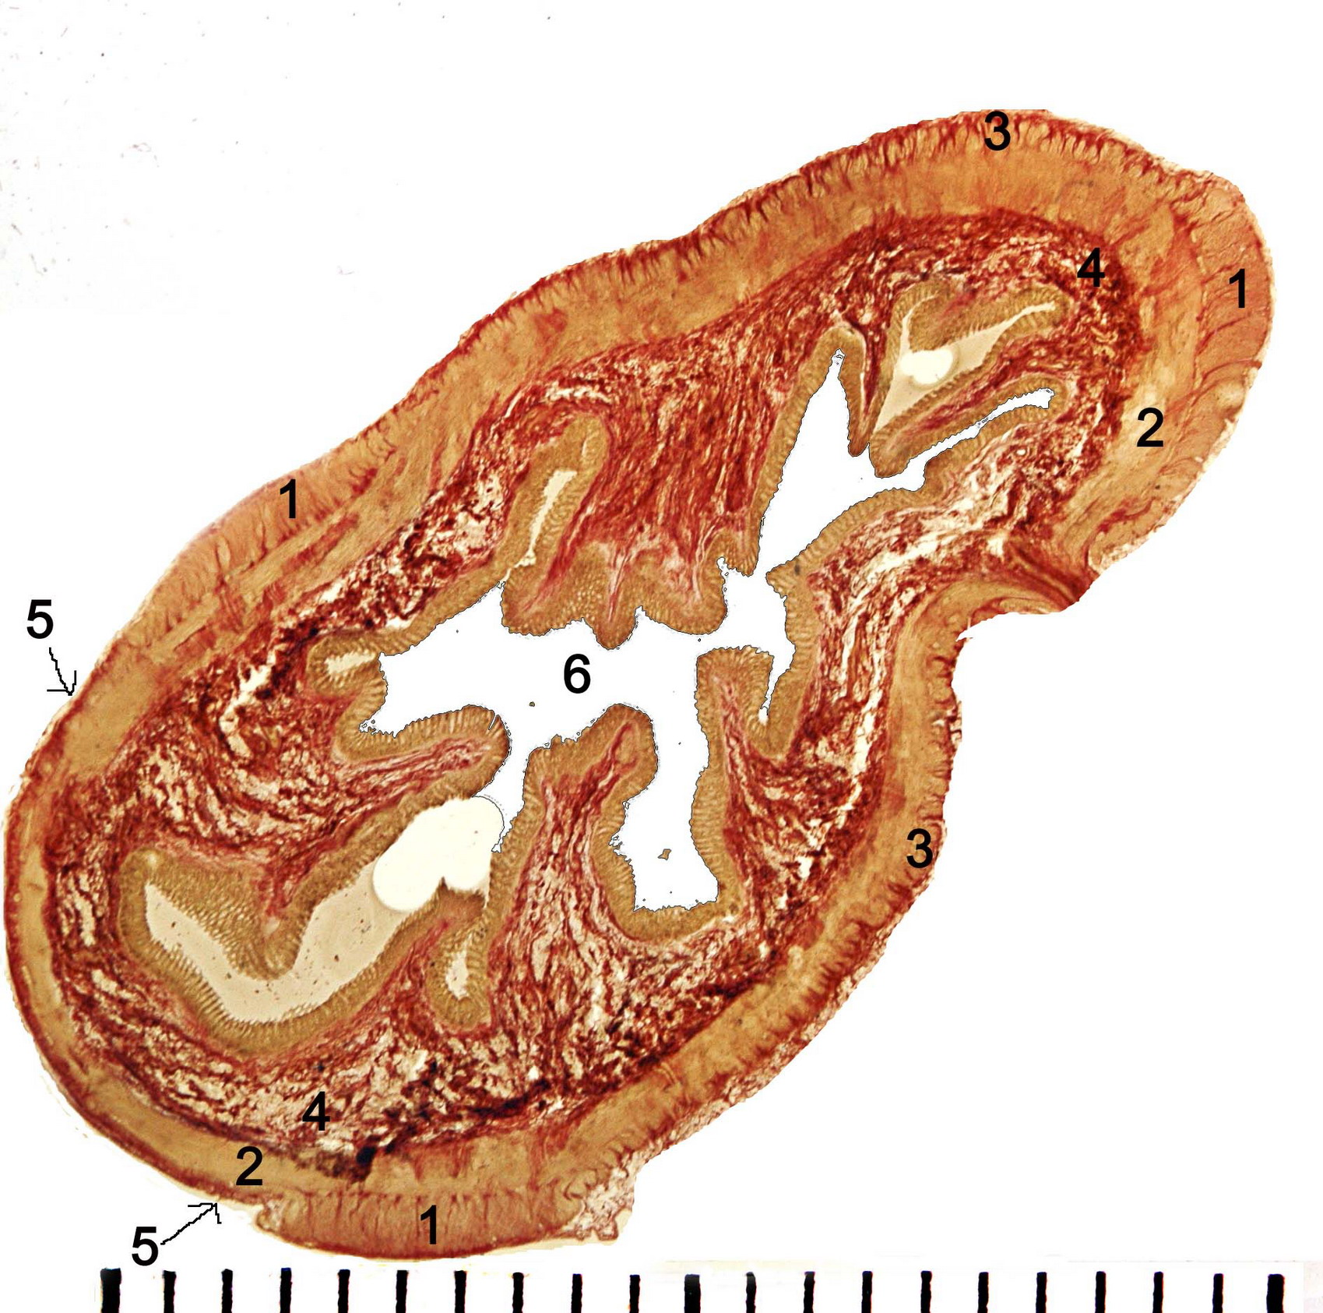
Colon ascendens

Slide 21
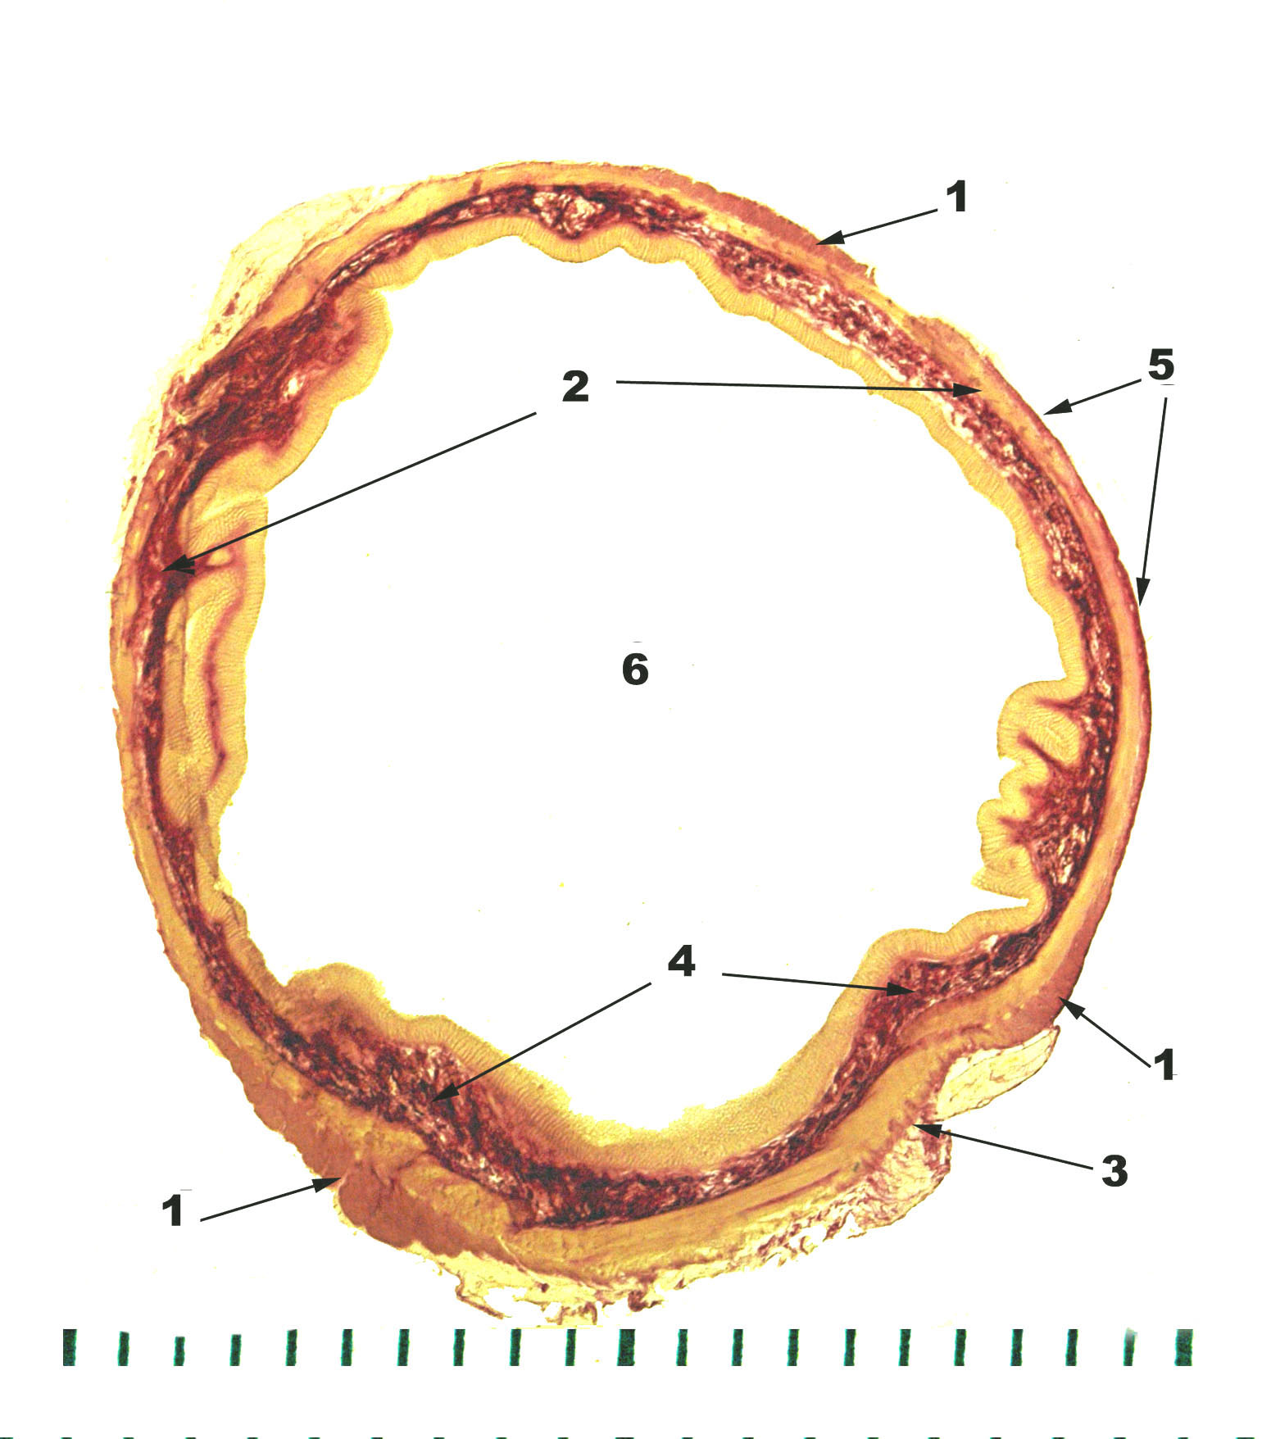
Colon transversum

Slide 22
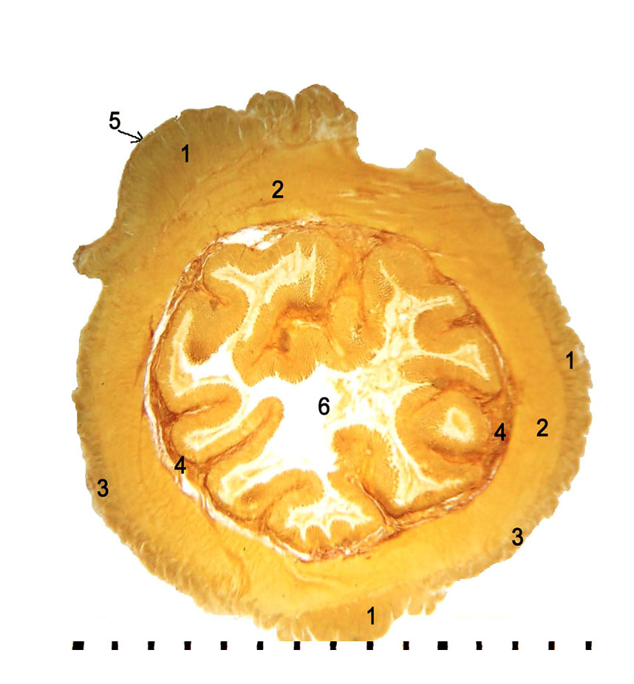
Colon sigmoideum

Slide 23
TNM Staging Classification of CRC
Primary tumor (T)
TX - Primary tumor cannot be assessed
T0 - No evidence of primary tumor
Tis - Carcinoma in situ: intraepithelial or invasion of lamina propria
T1 - Tumor invades submucosa
T2 - Tumor invades muscularis propria
T3 - Tumor invades through the muscularis propria into the subserosa or into nonperitonealized pericolic or perirectal tissues
T4a - Tumor directly invades other organs or structures, and/or perforates visceral peritoneum
T4b - Tumor directly invades other organs or structures, including other departments of a large intestine.
Regional lymph nodes (N)
NX - Regional lymph nodes cannot be assessed
N0 - No regional lymph-node metastasis
N1 - Metastasis in 1 to 3 regional lymph nodes
N2 - Metastasis in 4 or more regional lymph nodes
Distant metastasis (M)
MX - Distant metastasis cannot be assessed
M0 - No distant metastasis
M1 - Distant metastasis:М1a-1 organ(hepar, lung etc.), M1b- 2 and more organs or peritoneum

Slide 24
Clinical forms CRC
Toxico - anemia
Coloenteritis-like
Dyspepsia-like
Obturative
Pseudo-inflammatory
Tumoral, or atypia

Slide 25
Clinical sings
Related to tumor size, type, location
Ascending colon- the tumor is large, exophytic, bulky and offer:
  Abdomen Pain
  Bleed PR
  Unexplained anemia
  fatigability or weight loss
Descending colon- offer infiltrating, annular, obstructive tumor
  Altered bowel habits
  Decreased stool calibre
  Frequent gas pains, bloating, fullness, cramps
  Mass P/A

Slide 26
CLINICAL SIGNS
Abdominal pain 44%
Change in bowel habit 43%
Hematochezia or melena 40%
Weakness 20%
Anemia without other gastrointestinal symptoms 11%
Weight loss 6%
Some patients have more than one abnormality
15 to 20% of patients have distant metastatic disease at the time of presentation

Slide 27
DIAGNOSIS
Complete history
Physical examination /DRE
Routine investigations
Confirmatory- Biopsy
Staging workup
  CXR
  Barium enema
  Colonoscopy
  USG
  CECT abdomen-pelvis
  Virtual colonoscopy
  MRI
  PET
Gold standard- Colonoscopy+ Biopsy
Others
  FOBT
  Stool cytology
  CEA
  IHC markers- keratin
  Molecular markers- oncogenes
  DNA flow cytometry
  Immunoscintigraphy
Screening investigations

Slide 28
Diagnostic Tests
Digital rectal exam (DRE) - оbligatory research
Barium enema (BE) with or without air contrast: used primarily to locate deformities of intestinal topography
Sigmoidoscopy, rigid type or flexible fiber optic type: used to visualize local rectal tumors or for routine screening
Colonoscopy (or colon endoscopy): Direct visual examination of the colon and rectum detects early polypoid tumors preoperatively and recurrences post-resection; Multiple biopsies may be performed at time of study to increase sensitivity
Computed tomography (CT): Used to stage disease and identify metastases
Transrectal ultrasound (TRUS): An excellent choice for preoperative staging of rectal carcinomas, included changes in mesorektum.
Magnetic resonance imaging (MRI): very useful for diagnosing metastatic disease
Laparoscopy, -tomy: Useful in detecting metastases to abdominal regions (especially omentum, peritoneum or liver) that often remain undetected by current imaging techniques

Slide 29
Performance & Benefits
Complexity, limitations of tests
Flexible Sigmoidoscopy • Fairly quick • Few complications • Minimal bowel preparation • Does not require sedation or a specialist | Performance: High for rectum & lower one-third of the colon Complexity: Intermediate | Views only one-third of colon • Cannot remove large polyps • Small risk of infection or bowel tear • Slightly more effective when combined with annual fecal occult blood testing • Colonoscopy still needed if abnormalities are detected • Limited availability
Colonoscopy • Examines entire colon • Can biopsy and remove polyps • Can diagnose other diseases • Required for abnormal results from all other tests | Performance: Highest Complexity: Highest | • Full bowel preparation needed • Can be expensive • Sedation of some kind usually needed, necessitating a chaperone to return home • Patient may miss a day of work. • Highest risk of bowel tears or infections compared with other tests

Slide 30
Performance & Benefits
Complexity, limitations of tests
Double-contrast Barium Enema • Can usually view entire colon • Few complications • No sedation needed | Performance: High (for large polyps) Complexity: High | • Full bowel preparation needed • Some false positive test results • Cannot remove polyps or perform biopsies • Exposure to low-dose radiation • Colonoscopy necessary if abnormalities are detected • Very limited availability
Computed Tomographic Colonography • Examines entire colon • Fairly quick • Few complications • No sedation needed • Noninvasive | Performance: High (for large polyps) Complexity: Intermediate | • Full bowel preparation needed • Cannot remove polyps or perform biopsies • Exposure to low-dose radiation • Colonoscopy necessary if abnormalities are detected • Not covered by all insurance plans

Slide 31
Complications of CRC
Intestinal obstruction
Perifocal inflammatory process
Perforation of a tumor
Intestinal bleeding
Invasion on surrounding organs and tissues

Slide 32
SURGERY
SURGRY is the GOLD STANDARD and principle therapy of primary and non metastatic Ca colon. Operation can be
-Curative (radical)
  Palliative
  Accurate disease staging
  Guides adjuvant treatment
Likelihood of cure is greater when disease is detected at early stage
Notes:
Since the advent of treatment, management of primary colon malignancies has been exclusively – SURGERY and with - improvement in surgical skills, aggressiveness and patient preparation and support – resectability has increased to ~90% and mortality ~2-10%

Slide 33
Treatment of CRC
Surgical excision:
Specific procedure depends on the anatomic location of the cancer, but typically involves hemicolectomy. Performance of a resection of transversal and sigmoid intestines at localization of a tumor in an average third of departments and lack of metastasises in regionaly lymph nodes is possible
Surgical resection of affected bowel with clear margins, along with the adjacent mesentery and at least 12 regional nodes
For rectal tumors, total mesorectal excision with a distal surgical margin of at least 2 cm is recommended
For tumors that are located within 6 cm of the anal verge, or involve the anal sphincter, wide surgical resection with abdomino-perineal resection and permanent colostomy is recommended
Local excision, for palliative treatment or simple polyp removal

Slide 34
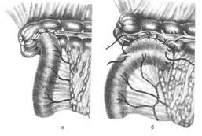
Ileotransversoanastomosis а – «end-to-side», б – «side-to-side»

Slide 35
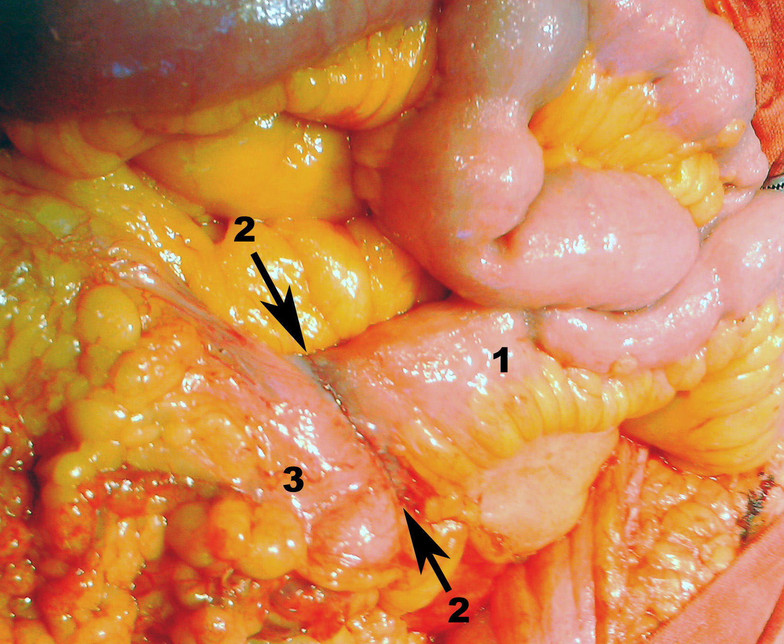
Ileotransversoanastomosis end-to-side by a microsurgical technique. 1 - an ileal intestine, 2 - an anastomosis suture line, 3 - a stump of transversal colonic intestine

Slide 36
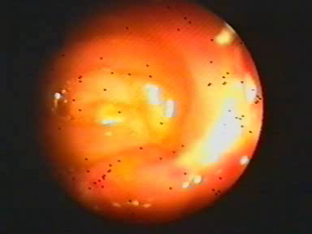
Ileotransversoanastomosis end-to-side by a microsurgical technique, 8 days.

Slide 37
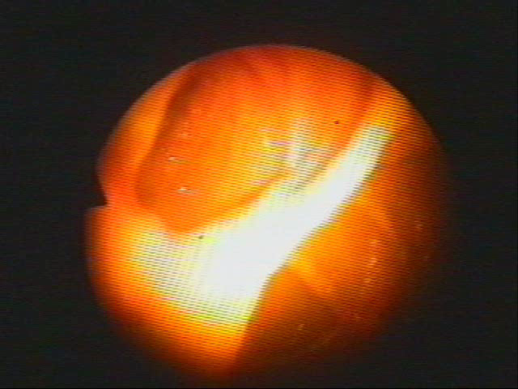
Ileotransversoanastomosis end-to-side by a microsurgical technique, 8 months.

Slide 38
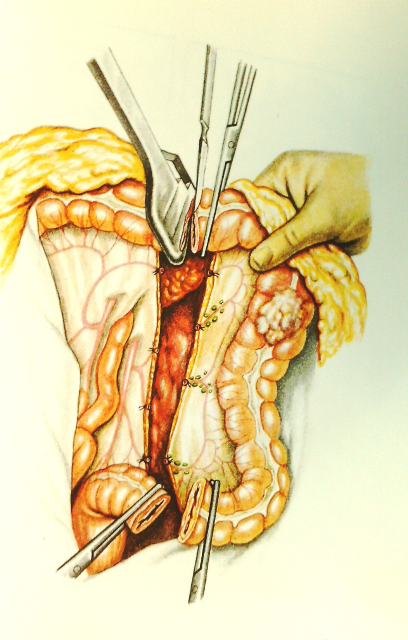

Slide 39
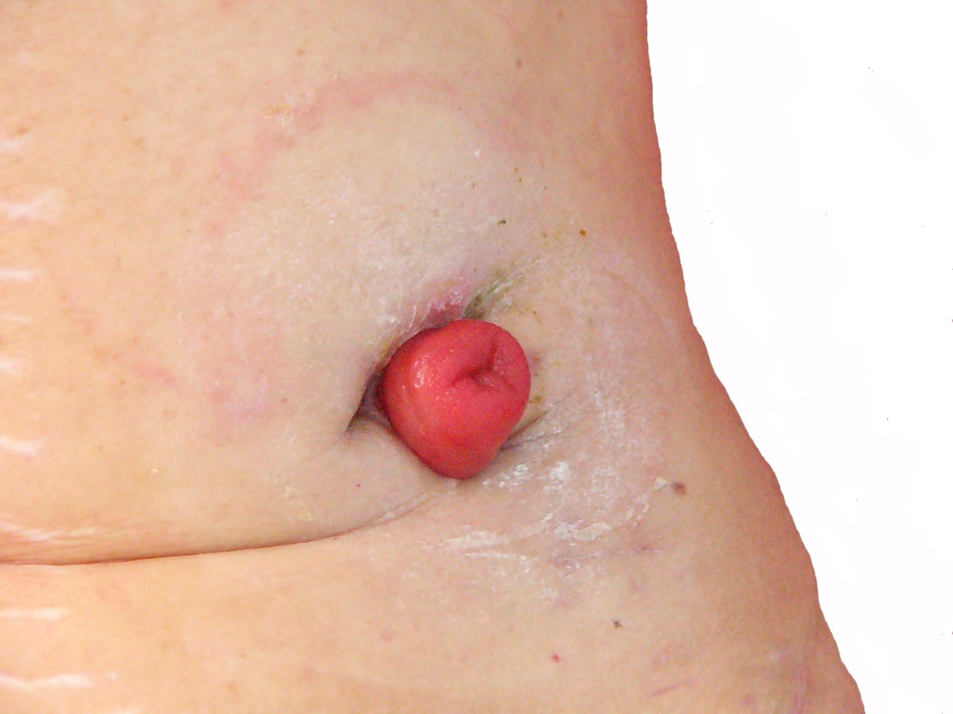

Slide 40
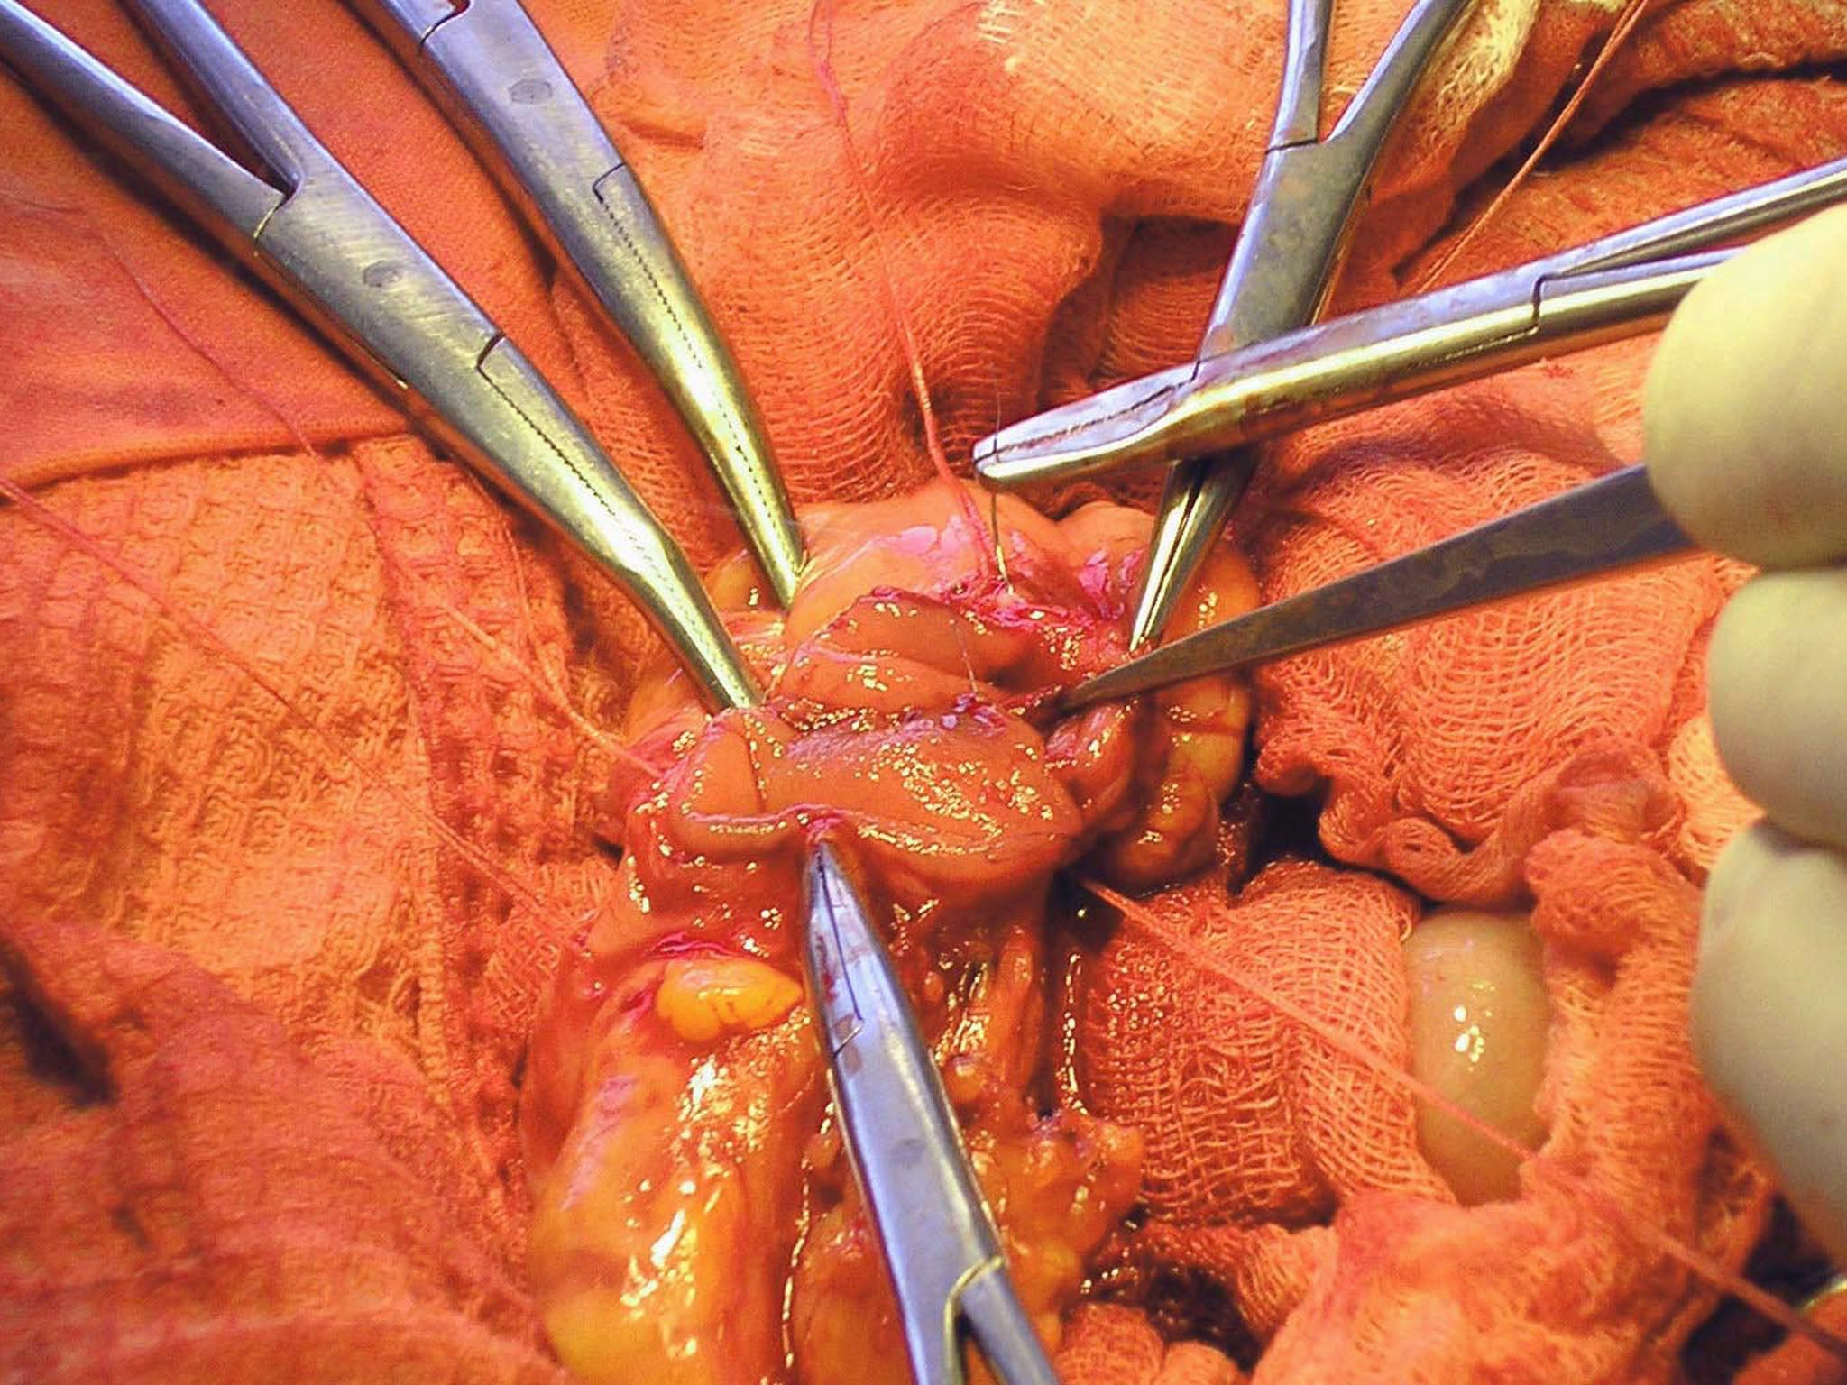

Slide 41
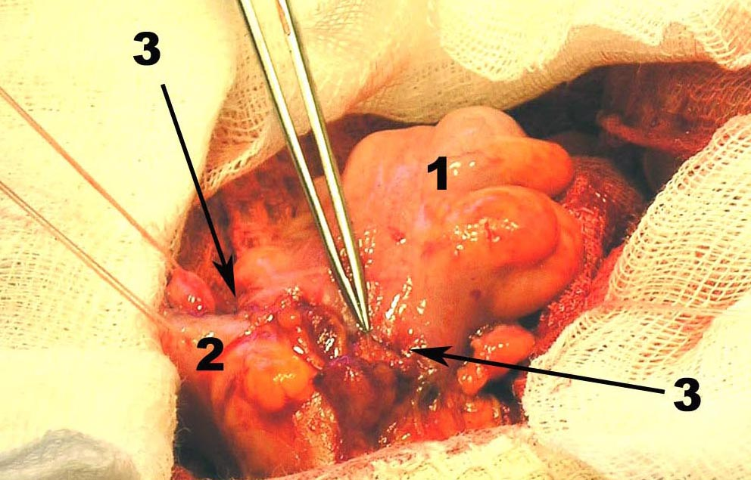

Slide 42
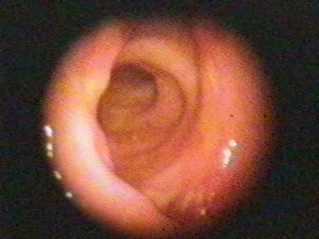
Sigmosigmoanastomosis end-to-end by a microsurgical technique, 6 days.

Slide 43
Radiation therapy:
Postoperative radiation, with or without chemotherapy, significantly reduces local recurrence rates
Common regimen incorporates infusional 5-fluorouracil (5-FU) as a radiosensitizer to boost the efficacy of pelvic radiation
Administered as 45 to 55 Gy over 5 weeks
Repeated as needed

Slide 44
Treatment
SYSTEMIC CHEMOTHERAPY
5-FU (5-fluorouracil) has been the mainstay of systemic chemotherapy for CRC
Capecitabine was approved in 2001 as first-line therapy for metastatic CRC
Irinotecan (Camptosar), Oxaliplatin (Eloxatin), Bevacizumab, Cetuximab
Electrocoagulation
Mostly palliative treatment for rectal carcinomas
Curative for small subset of patients

Slide 45
Screening for high-risk people
A first-degree relative (sibling, parent, child) who has had colorectal cancer or an adenomatous polyp: Screening should begin at age 40 years
Family history of familial adenomatous polyposis (FAP):
Screening should begin at puberty
Sigmoidoscopy - annually, beginning at age 10 to 12 years
Colonoscopy - every five years
Family history of hereditary nonpolyposis colorectal cancer (HNPCC):
Screening should begin at age 21 years
Sigmoidoscopy - annually, beginning at age 10 to 12 years Colonoscopy - every one to two years, beginning at age 20 to 25 years or 10 years younger than the earliest case in the family, whichever comes first

Slide 46
Screening for high-risk people
Personal history of adenomatous polyps: Screening should be based on pathological findings
Advanced or multiple adenomas (3 or greater): First follow-up colonoscopy should occur in 3 yrs; 1 or 2 small (< 1 cm) tubular adenomas: First follow-up colonoscopy should occur at 5 years
Personal history of colorectal cancer:
After colon resection
Approximately six months after the surgery
If the colonoscopy performed at six months is normal, subsequent colonoscopy should be repeated at 3 years and then if normal, every 5 years
Personal history of inflammatory bowel disease
Every one to two years after an eight year history of the disease with pancolitis or
Every one to two years after 15 years history of left-sided colitis or
For all patients beginning with eight to ten years of disease to document the extent of the disease

